Slide 1
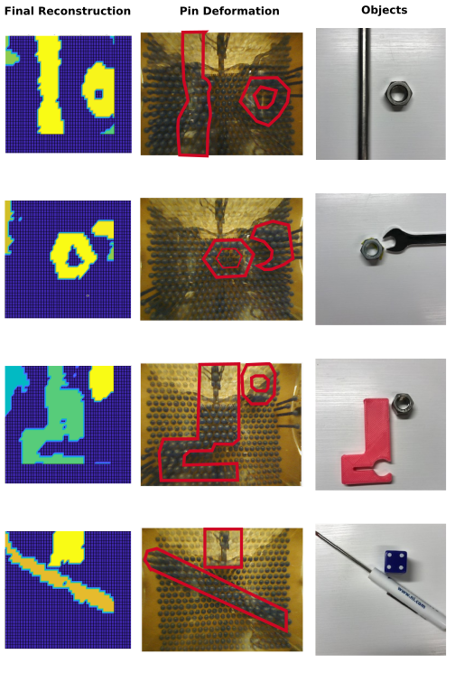
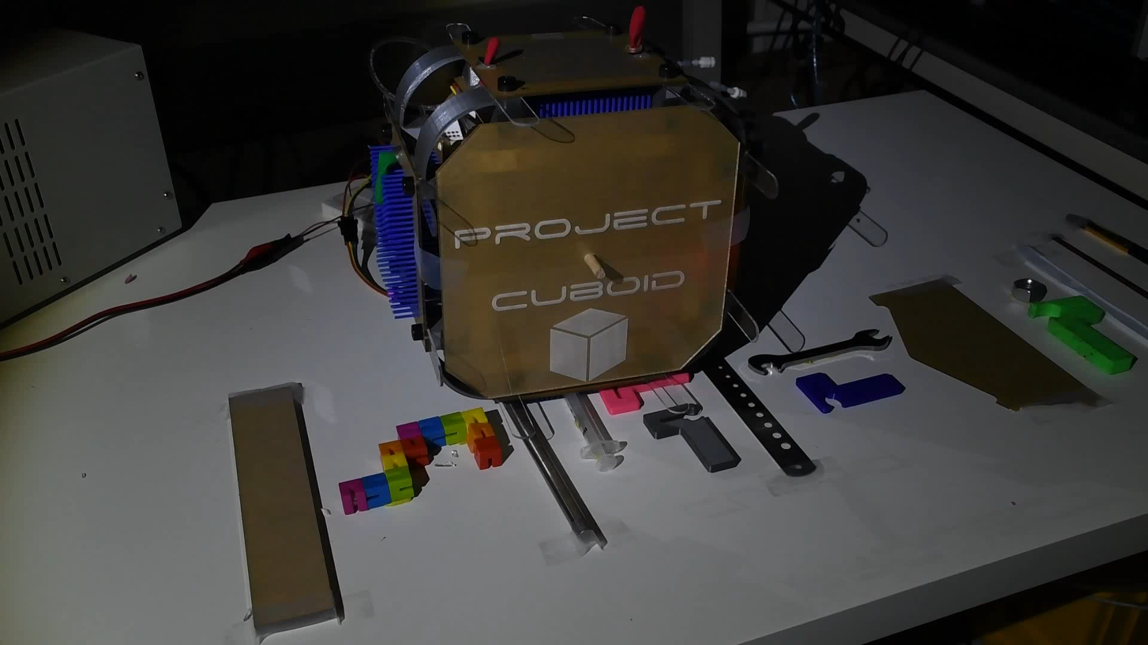
Project Cuboid
A cuboid with a dynamic contact surface for adaptable motion and topographic mapping on variable terrains.

